Slide 1

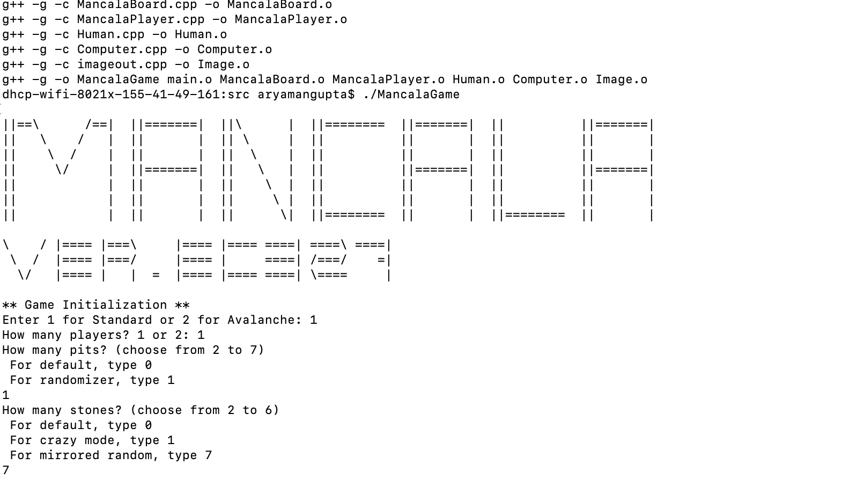
Mancala
ver. EC327
By probable-broccoli
Created with C++

Slide 2
Outline
Class hierarchy
Backend Logic
User Interface/Ascii art
Audio files

Slide 3
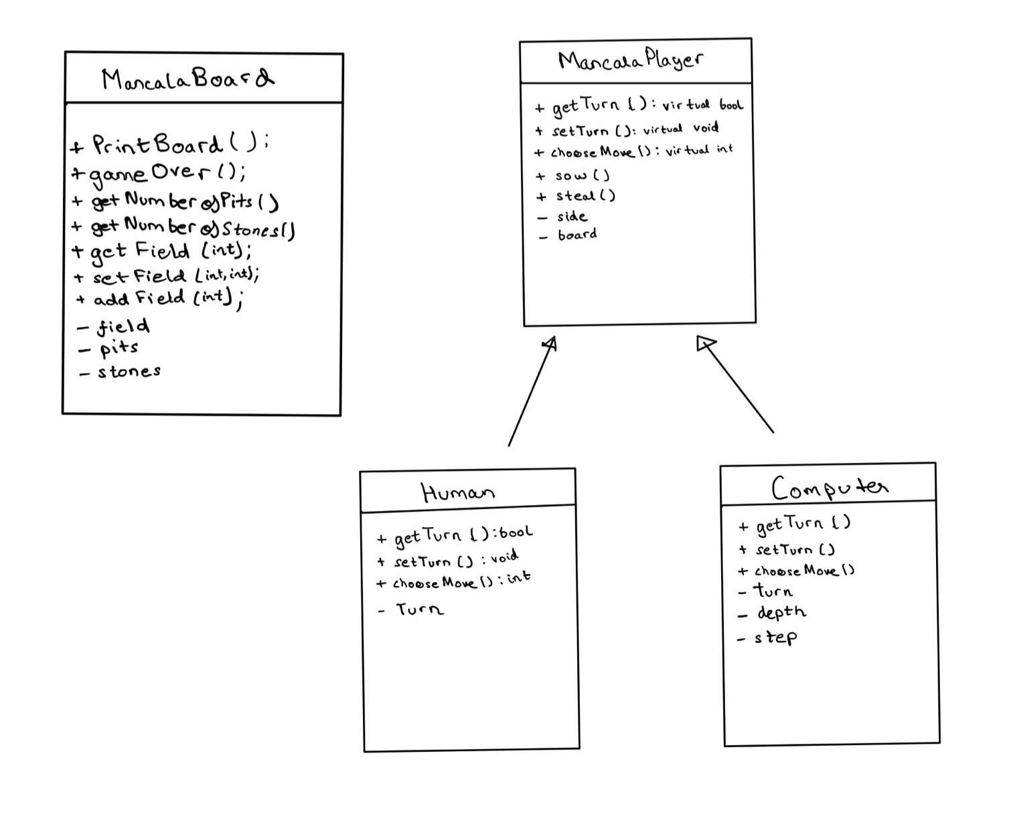
The UML Class Diagram

Slide 4
Added Game Modes and Features
As part of our milestones, we were able to implement:
-> different gameplay mode (Avalanche)
-> multiplayer capability of up to 2 players and/or with a competitive AI
-> layer-adjustable game selections, and an option to randomize the number of stones and pits on the board
-> user-friendly interface designs by adding ASCII screens and audio functions that enhance the user experience

Slide 5
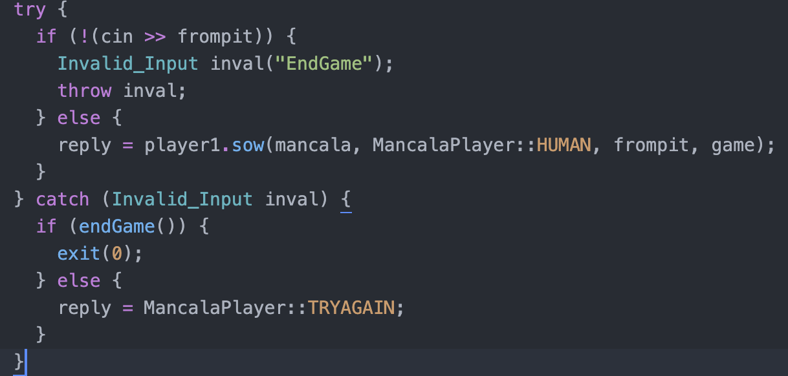
Error Handling
Example Code From main.cpp
Utilised Exceptions (try and catch blocks)
Included in Input_Handling.h

Slide 6
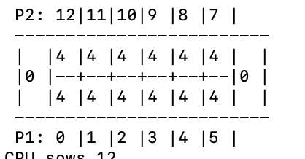
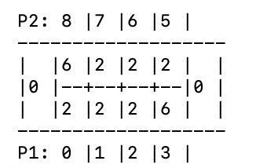
Utilised STL Library and Vectors
Used vectors to store the amount of stones in each pit as it dynamic and easier to integrate in a customisable game.
Example boards from games utilising different amount of pits and stones to showcase effectiveness of vectors:

Slide 7
Game Logic
Main takes User Input and calls the MancalaBoard class functions to create the board according to customisable options.
MancalaBoard is created using either user-specified input or randomised numbers. It is outputted to the terminal
The user chooses his move and MancalaPlayer (derived class: Human) makes the move and communicates it with MancalaBoard.
The CPU uses two different algorithms according to the game mode to decide when it’s the CPU’s turn.

Slide 8
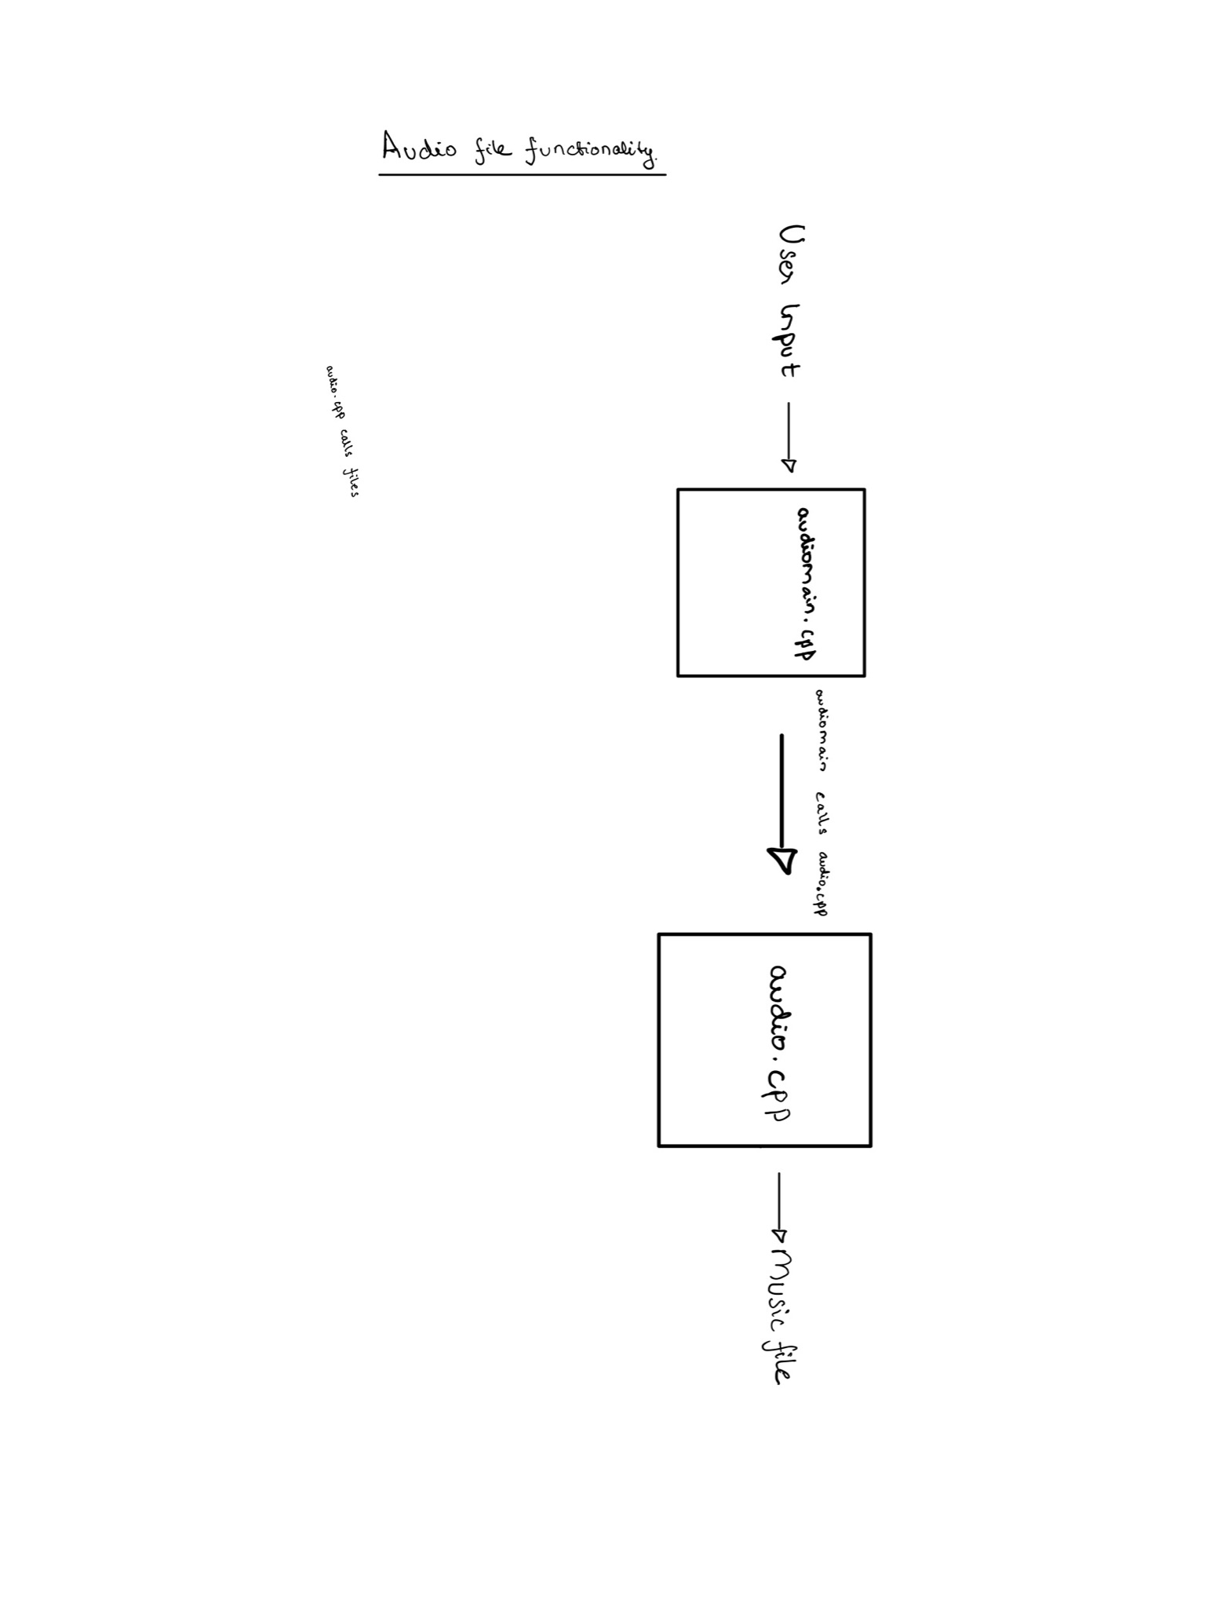
Audio File Architecture
-> The audiomain.cpp files outputs the possible background music for the user and takes user input for music selection.
-> audiomain.cpp calls audio.cpp with the selection of music
-> audio.cpp calls the corresponding music file -> Video mode window buffers the sound stream until window is closed

Slide 9
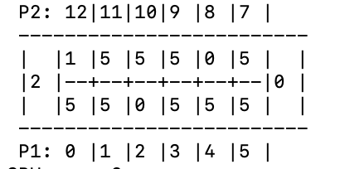
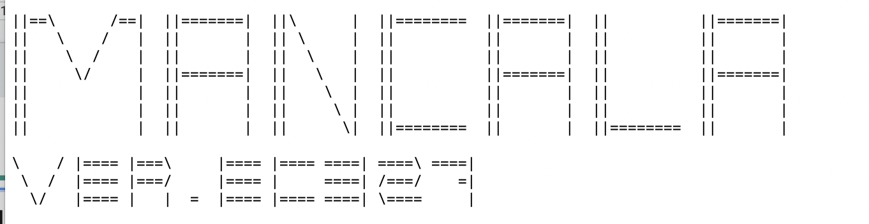
User Interface and Ascii Titles
Implemented an easy to follow Game Board that outputs on the Terminal, made using for loops that iterate through the vector Field in MancalaBoard.
Added Ascii Art to make the game more engaging and entertaining in imageout.cpp

Slide 10
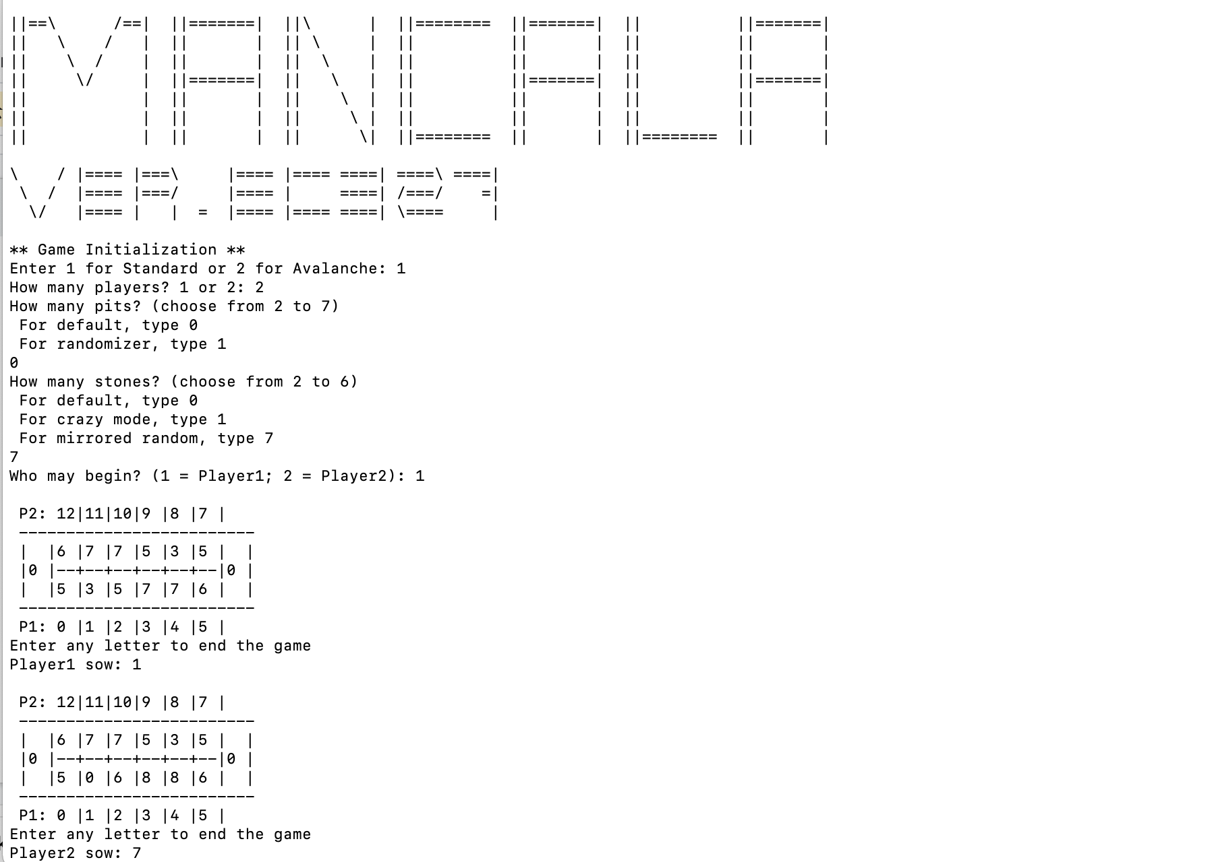
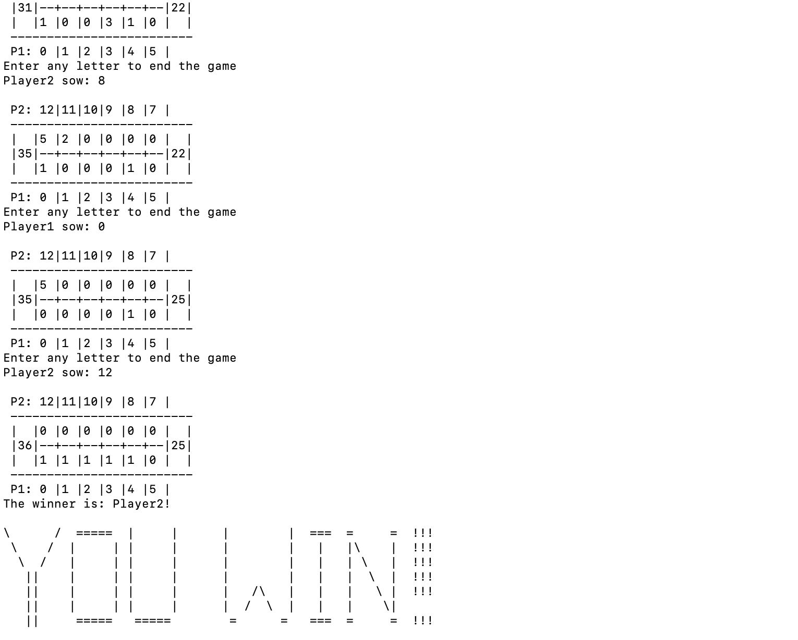
Example Gameplay

Slide 11
Probable-broccoli:
Aryaman Gupta - Specification Lead
Bora Bulut - Documentation lead
Zachary Tan - Technical Lead
Sally Shin - Project Lead
Fariza Tasnim - Interface Lead

